Slide 1

Accessibility for statistics teaching and learning materials: opportunities and challenges
David McArthur, Craig Alexander, Colette Mair
University of Glasgow

Slide 2
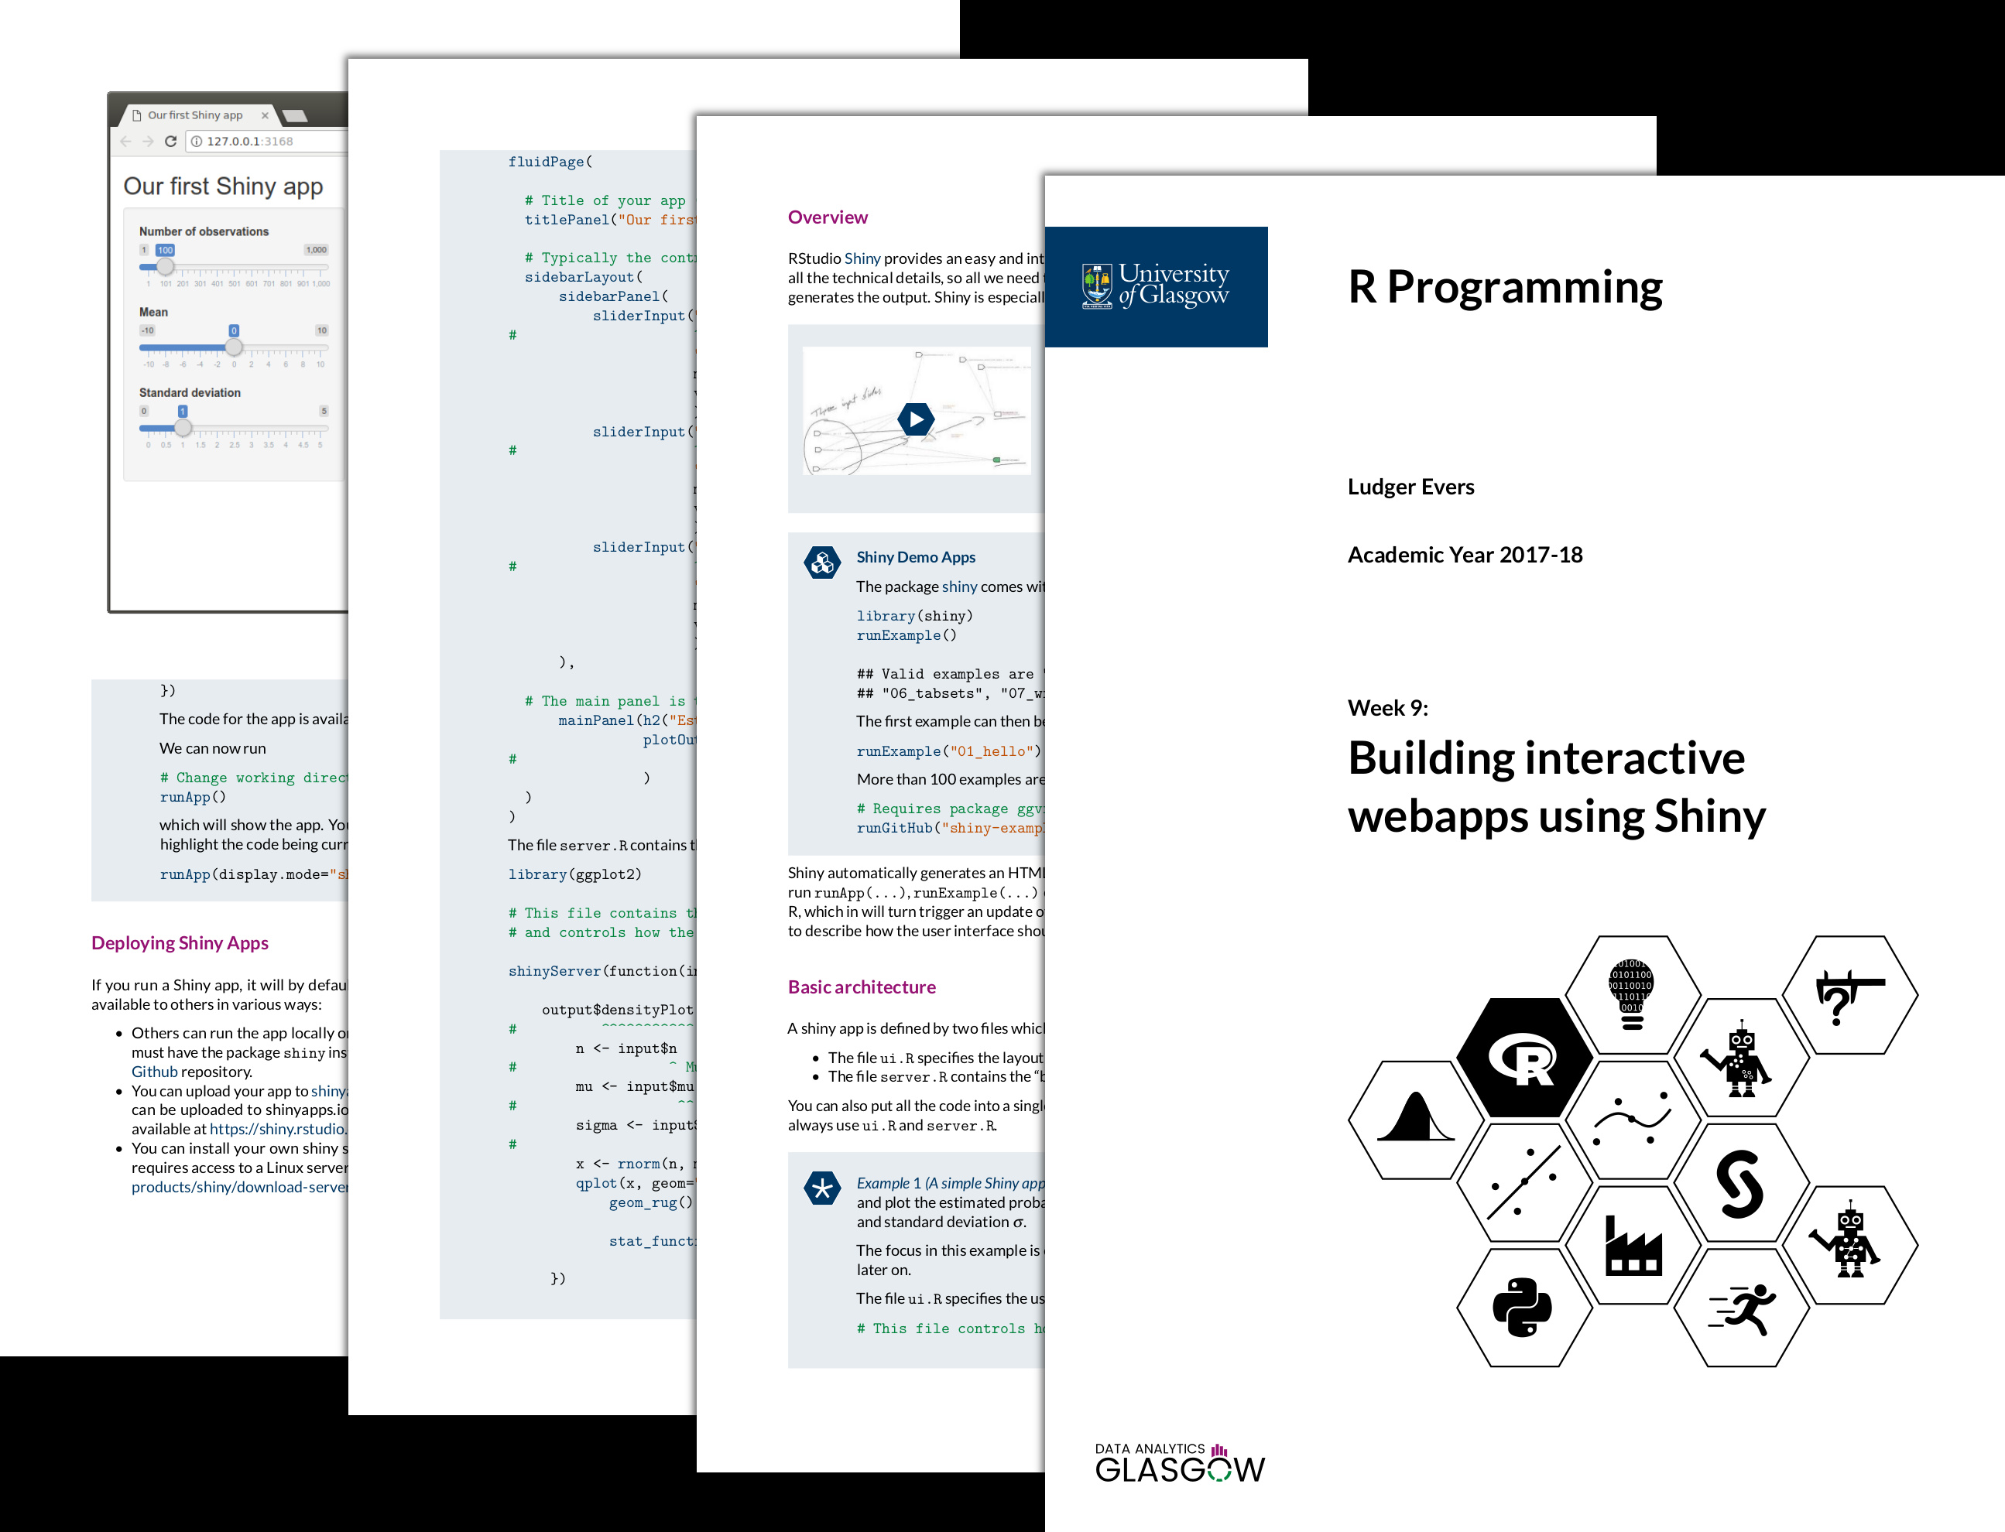
Case Study: ODL Learning materials – the past
Asynchronous content presented within PDF format.
Notes embedded with online Khan Academy style tutorials and tasks.
Older versions of course notes did not include any accessible features.

Slide 3
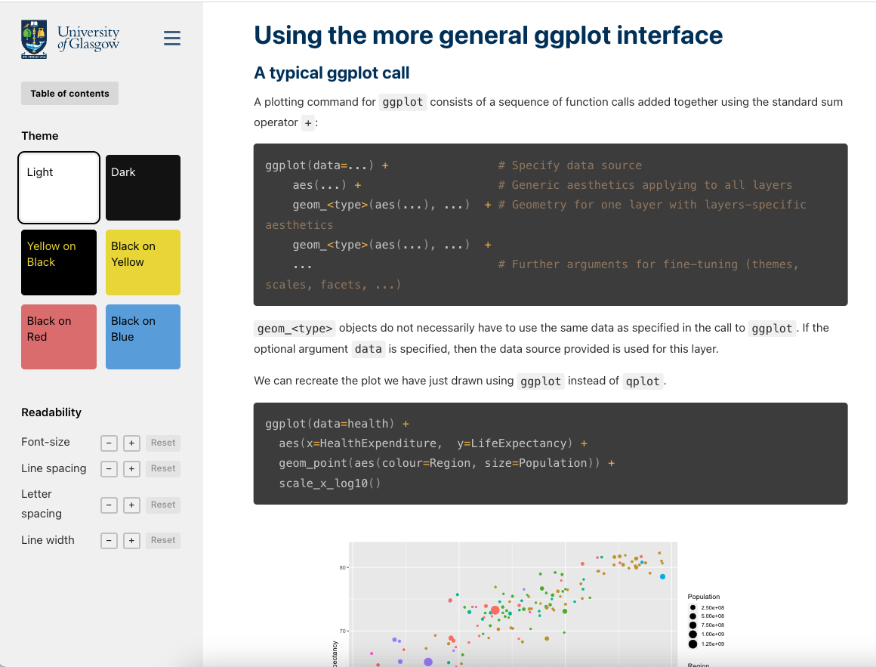
Case Study: ODL Learning materials – the present
Developed by ODL full stack web developer David McArthur.
Motivation to create accessible notes that do not just pass accessibility tests but cater for a variety of physical and cognitive disabilities.
Accessibility features can help everyone, from feedback, some students like to study on the go using mobile devices, using dark mode for viewing.

Slide 4
Design Considerations
Holistic approach, build accessibility in from the start:
Create features that are thoughtful, concentrate on simplicity instead of passing accessibility tests.
Create features that can be useful for everyone - features that are widely used will be actively maintained and improved.
Provide options rather than one-size-fits-all.

Slide 5
HTML notes
HTML > PDF for accessibility:
Wide selection of accessibility tools designed for HTML that work on all major platforms and devices.
Responsive - HTML can adapt to different sized screens to provide the clearest layout.
Opens the door to richer experiences such as interactivity and animation.
It’s possible to provide an accessible PDF derived from accessible HTML.

Slide 6
The html file
Self-contained - as portable as a PDF file and can be opened with any web browser.
Simple and distraction-free design.
Sidebar with Table of Contents to facilitate easy navigation.
A View Options pane allowing the user to change colour, spacing and sizes of the page content.

Slide 7
The html file
Responsive - adapt from the smallest mobile screens to largest desktop screens.
Answers next to tasks to avoid excessive scrolling.
Use Scalable Vector Graphics wherever possible to ensure graphics look crisp and in focus even when zoomed in.
Follow best practices for creating semantic, accessible HTML code.

Slide 8
The pdf file
Providing options - some users prefer a paper-like representation of course notes.
Chromium, the open-source foundation of the Chrome browser, can create an accessible “tagged” PDF from an HTML document
Task answers are moved to the end due to lack of interactivity.

Slide 9
Student Feedback
“Cleaner and neat look”, “Task solutions attached to task saves scrolling”, “3-bar menu helpful for navigating sections”.
Features such as theme and font size are used by students often.
Some helpful suggestions for development, such as copy/paste options for code blocks & facilities for note taking.
PDF notes still used by students for at-home study and note taking.

Slide 10
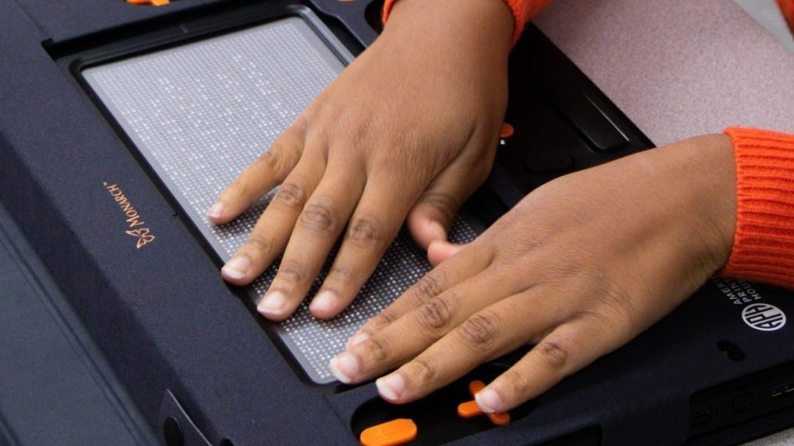
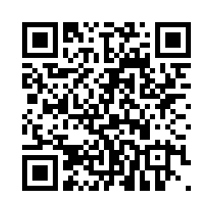
Going Beyond Accessibility Regulations
Though accessibility regulations (e.g. Public Sector Bodies Accessibility Regulations) are a good start to improving accessibility, they do not break down all accessibility barriers.
Current study investigating accessibility for visually impaired learners
Levels of discouragement from pursuing University mathematics due to restrictive barriers.
The ‘eBRF Revolution’ shows promising development in setting new coursework standards for conversion to Braille and tactile graphics.
We are currently undertaking a short study into improving accessibility of mathematics for visually impaired learners. You can access the survey by scanning the QR code.
American Printing House

Slide 11



Thank you for listening
Any questions?
#UofGWorldChangers
@UofGlasgow

